Slide 1
COGS 109 Review Friday Section
Connie Guan

Slide 2
Overview
Types of models
Regression
Classification
Resampling

Slide 3
Prediction vs Inference
Prediction: Attempting to predict a y value for some x value based off existing x, y values
“Given some temperature data and snow boot sales data I want to predict how many snow boots I will sell if the temperature is 15 degrees.”
Inference: Attempting to infer which predictors are significant in predicting some y
”Given temperature data, spatula sale data, and sea level data I want to know if there is a relationship between any of these predictors and snow boot sales”

Slide 4
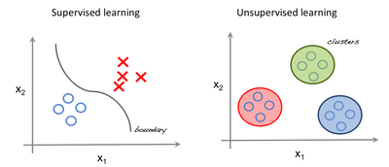
Supervised vs unsupervised
Supervised: ”Correct” y values are given to model
Regression, classification
Unsupervised: Allow model to “learn” the different categories within the data
Clustering

Slide 5
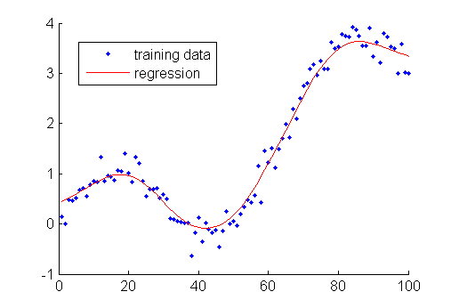
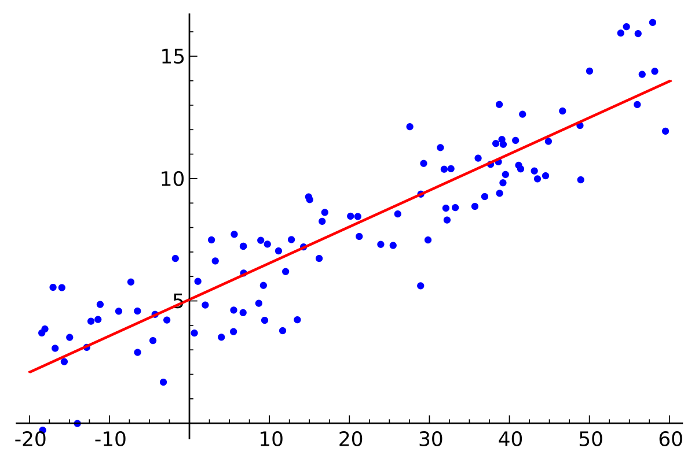
Flexible vs Inflexible Models
Flexible Models:
High variance, low bias
Non-parametric Models: Powerful, but difficult to interpret
Overfitting
Inflexible Models
Low variance, high bias
Parametric Models: Less powerful, but easy to explain
Less danger of overfitting
Notes:
Variance: how much the model changes with variance in the data
Bias: error introduced by the model itself

Slide 6
Overfitting: training and testing error
Training Error: Error from running model on the X, Y data used to fit the model
If too low could indicate over fitting
Testing Error: Error from running model on new X data that the model has never seen before

Slide 7
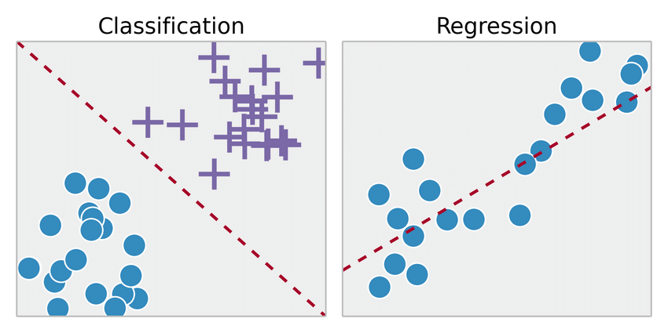
Regression vs classification
Regression:
Predict a continuous value
Mean Squared Error
”Based off the features I predict that the dog’s weight will be 15 lb”
Ex. Linear regression
Classification:
Predict a categorical label for the data
Error rate
“Based off the features I predict that the dog is male”
Ex. K-nearest neighbors, logistic regression, LDA

Slide 8
Model selection
What type of problem/question do we have?
Regression vs classification?
Is there a linear relationship?
Non linear relationships requires a more model
Is there a lot of noise in data?
Flexible models introduce more noise
How much data do we have?
Complex models often require more data to account for higher variance

Slide 9
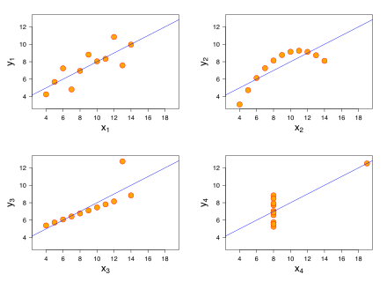
Regression: Linear regression
Fit data to a linear line
Minimize sum squared error ie. minimizing the sum of the squared differences between predicted value and actual value
Y = b₁x₁ + C

Slide 10
Multiple Linear Regression
Multiple linear regression fits all categories into one equation
Y = a₁x₁ + a₂x₂ + C
Why use multiple linear regression instead of multiple simple linear regressions?
Notes:
Which predictors are significant if we hold the others constant?

Slide 11
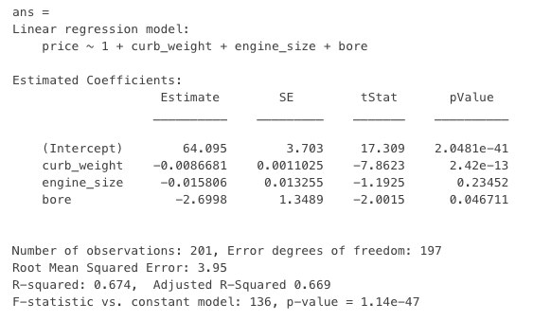
Regression Table
This is a linear regression table generated by predicting price by weight, engine size, and bore
Can you interpret the meaning of everything in this table?
Notes:
P value: statistically significant if < 0.05
Means that

Slide 12
Statistics
Standard Error: measure of preciseness; how far this estimated value is from the true population value
Standard Deviation: measure of variability in data
R²: measure of correlation ie. how much of variance is explained by model. 0 means model accounts for 0% of variance and 1 means model accounts for 100% of variance
P-value: measure of significance of result. Probability of seeing this result assuming null hypothesis is true. Typically reject null hypothesis is < 0.05
T-statistic: measure of significance of result
Confidence Interval: confidence range; confidence interval of 95% means 95% certain that true value falls within this interval = coeff +/- 2 * SE

Slide 13

Dummy variables
Method of encoding categorical variables to fit models
Categories: Red, Green , Blue
What is the difference between following two encodings?
Green: 01 Green: 01
Blue: 10 Red: 10

Slide 14
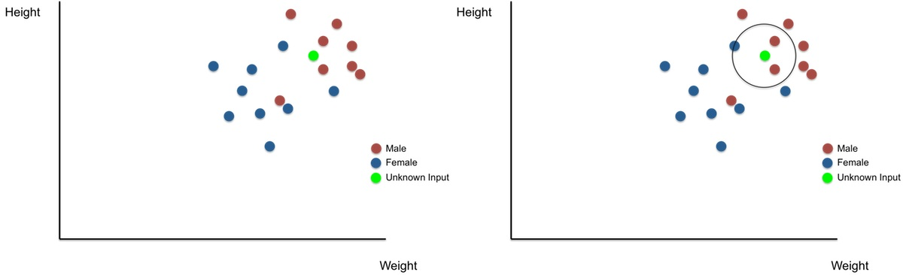
Classification: K nearest neighbors
Label an unknown data point with the same label that is seen most often in it k nearest neighbors

Slide 15
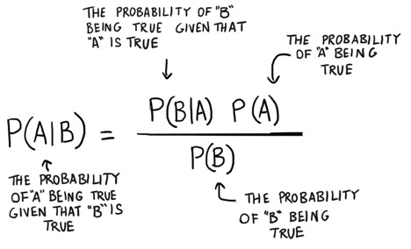
Bayes Theorem
A theoretical ideal
In practice we do not know P(B|A) , must estimate it

Slide 16
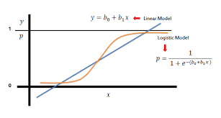
Logistic regression
Classification of 2 classes
Predict probability P(y=1| x) or P(y=1|x)
Mathematically: a logistic regression learns the likelihood from input data

Slide 17
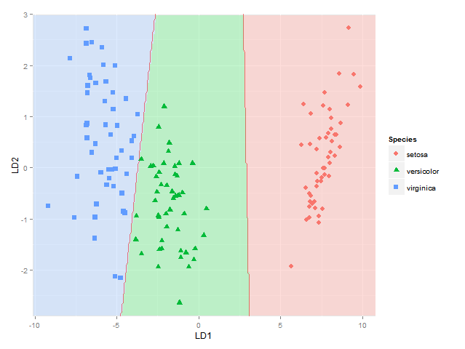
Linear Discriminant Analysis
Classification of 2+ categories
Makes certain assumptions about input data
Likelihood is normal
Variances are all equal

Slide 18
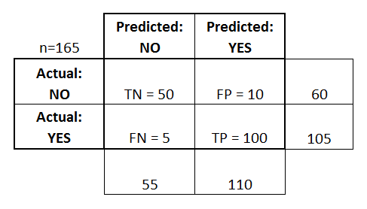
Confusion matrix
True Pos: # positives model found that were really positives
True Neg: # negatives model found that were really negatives
False Pos: # positives model found that were really negatives
False Neg: # negatives found that were really positive

Slide 19
Evaluating a classifier
Sensitivity: True positive rate
TP / TP + FN
Specificity: True negative rate
TN / TN + FP
Can you calculate sensitivity and specificity of this confusion matrix?

Slide 20
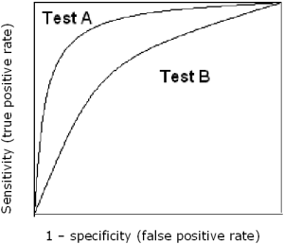
Receiver operating characteristic
ROC curve plots true pos rate against false negative rate of a model
Which test is likely preferred?

Slide 21
Resampling
Resampling: drawing repeated samples from one data set
Uses:
Model assessment
Model selection

Slide 22
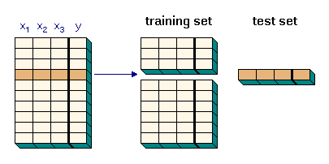
Cross Validation
Split data in testing-training
Fit model with training data set
Evaluate model using testing set

Slide 23
Splitting Testing-Training
Leave one out cross validation
K-folds cross validation
Bootstrap resampling

Slide 24
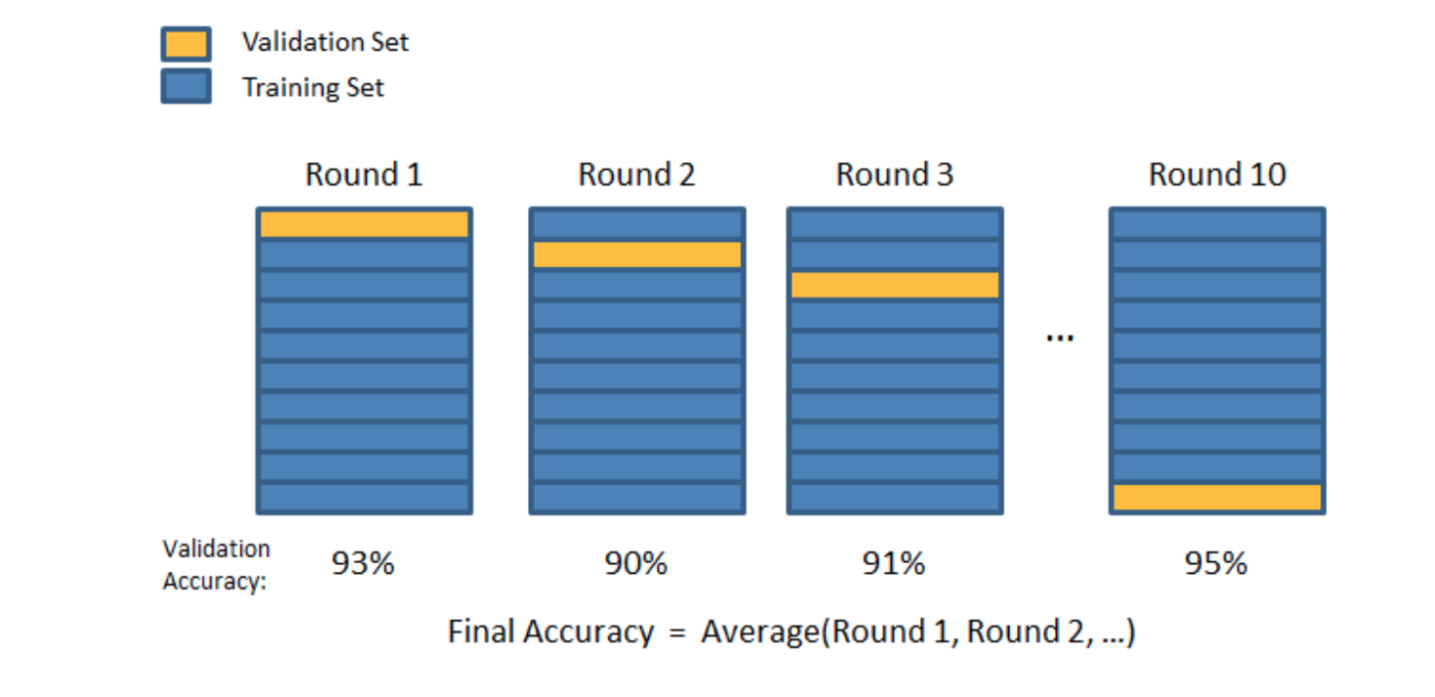
Leave one out
Select one data point as testing
Remaining n-1 points are training
Do this n times, each time choosing a different point to leave out
Pros: Accurate, use almost all data
Cons: Expensive

Slide 25
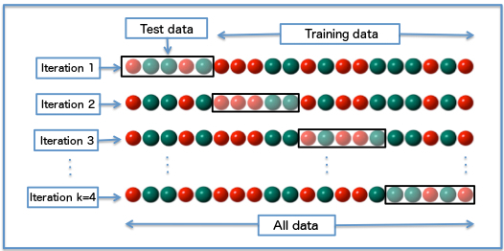
K-Folds
Randomly separate data in k groups or “folds”
Select one fold as testing
Train on n-1 remaining folds
Repeat k times, selecting a different fold as testing each time

Slide 26
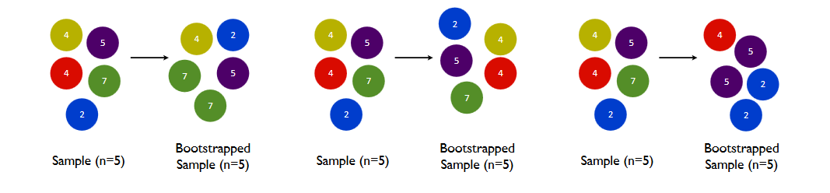
Bootstrap resampling
Create ”new” data sets by sampling with replacement
Train on “new” data sets
Test against original set

